Slide 1
System Architecture
Testing and validation plaforms
Master’s Degree in Smart Energy Systems

Slide 2
Contents
What is a System Architecture
Systems and Emergence
Architecture and Views
Analysis of System Architecture
Form and Function
Structural Decomposition and Functional Decomposition
View types

Slide 3
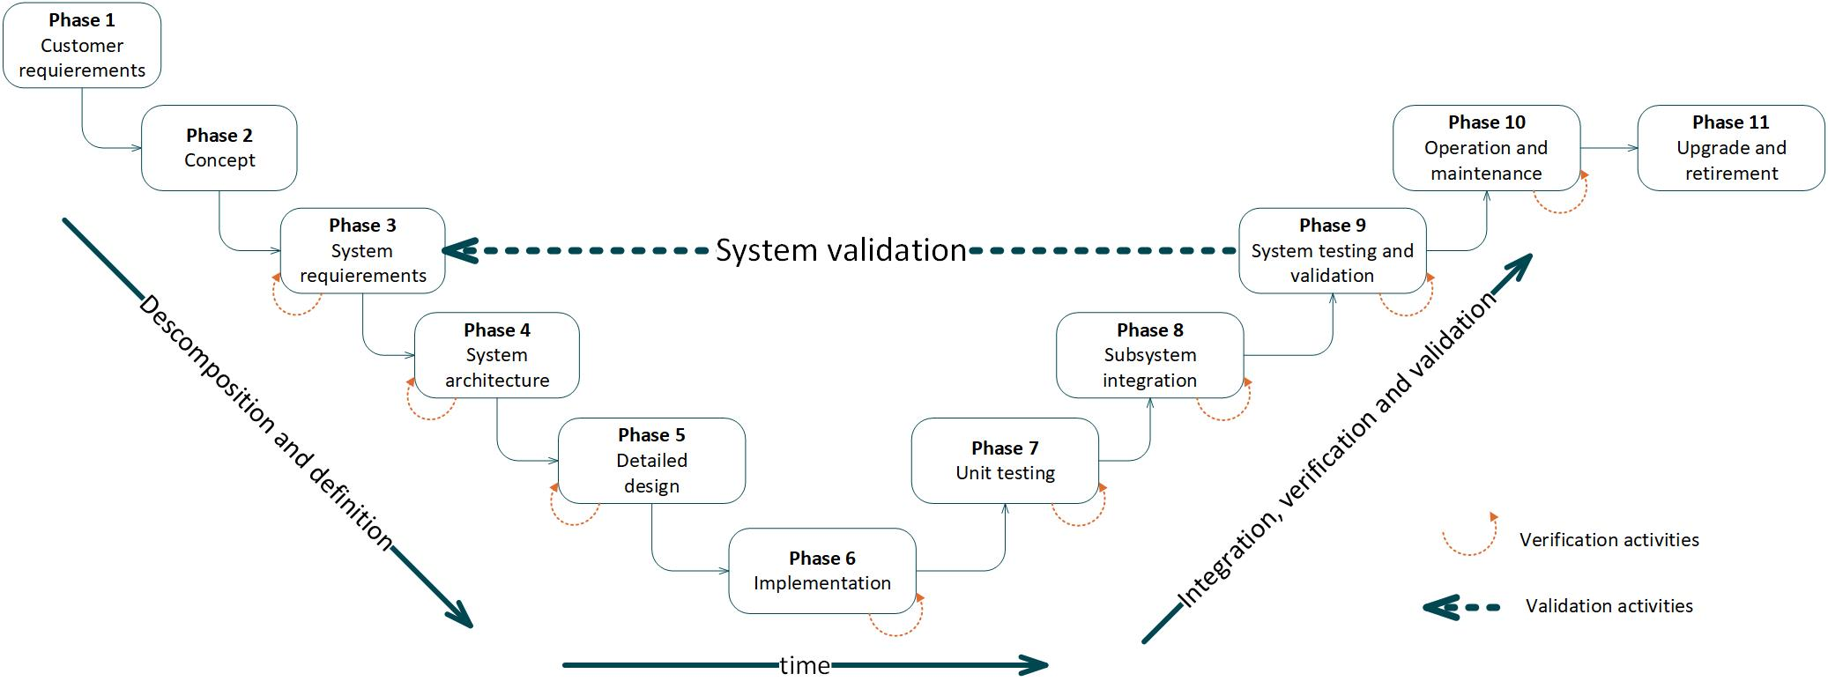
Contents
3. Architecture

Slide 4
What is a System Architecture
1

Slide 5
What is a System: Emergence
A system is a set of entities and their relationships,
whose functionality is greater than the sum of the individual entities. Crawley, E. et al., (2016)
System Architecture. Pearson.
A system is not the sum of the parts, but the product of the interaction of those parts.
Russell Ackoff.

Slide 6
What is a System Architecture
Architecture
It is the conceptual model that defines the structure, behavior, and more views of a system. Hannu Jaakkola and Bernhard Thalheim. (2011)
View
The purpose of views and viewpoints is to enable humans to comprehend very complex systems. Edward J. Barkmeyer et al. (2003)

Slide 7
Analysis of System Architecture
2

Slide 8
Structural and Functional Decomposition
2.1
Analysis of System Architecture

Slide 9
Form and Function
A system’s structure can be decomposed in two forms:
Structural decomposition (form).
Functional decomposition (function).

Slide 10
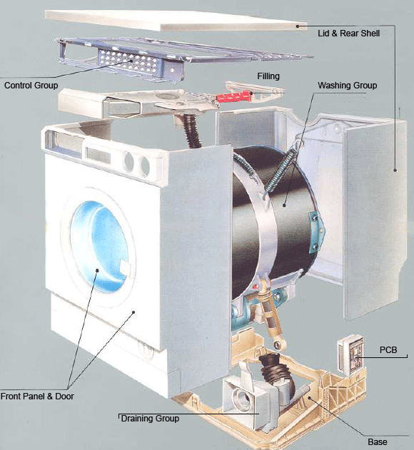
Structural Decomposition
Example: washing machine
Source: www.ukwhitegoods.co.uk/2967-washing-machine-a-washer-dryer-top-

Slide 11
Structural Decomposition
Example: washing machine
Source: www.ukwhitegoods.co.uk/2967-washing-machine-a-washer-dryer-top-

Slide 12
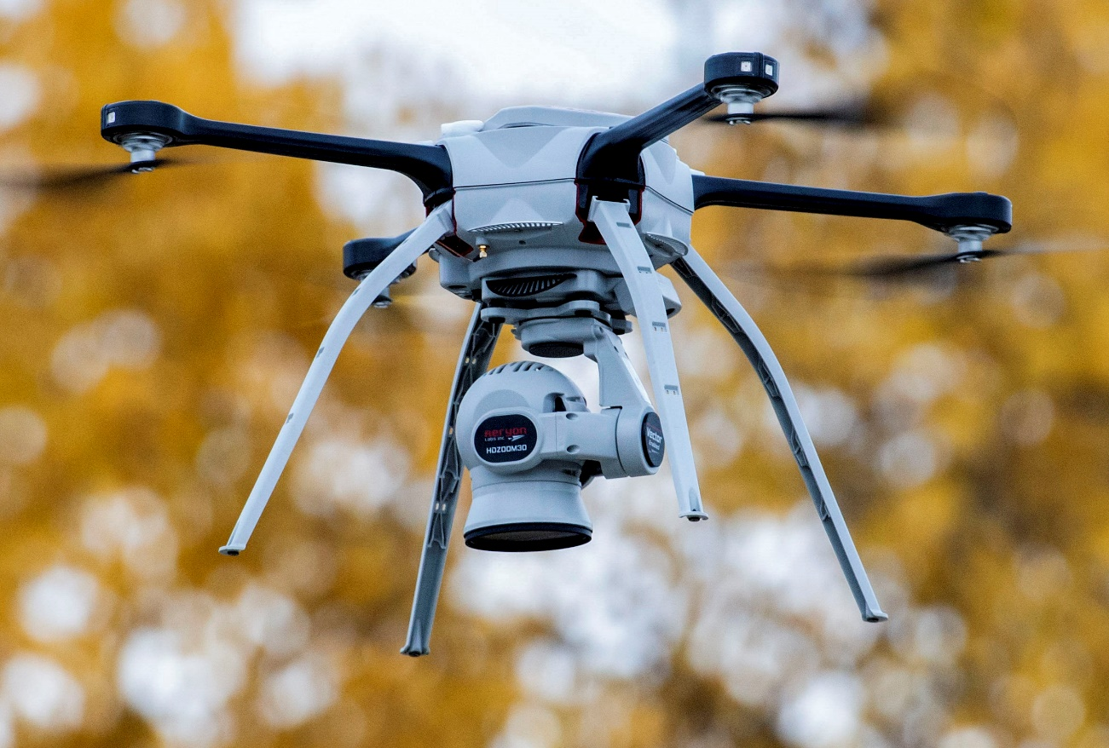
Functional Decomposition
Example: UAV function, Flight

Slide 13
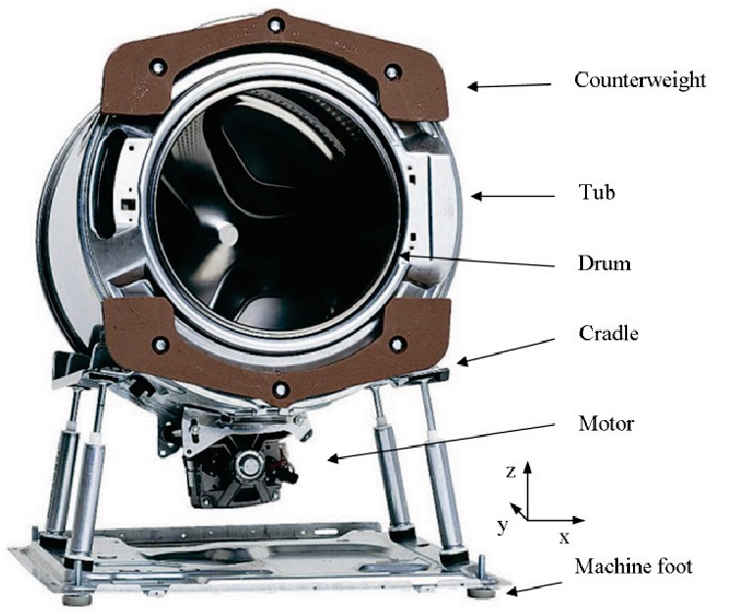
Decomposition hierarchy
Example: washing machine
Each subsystem is decomposed and organized in hierarchies
Source: www.semanticscholar.org/paper/Washing-Machine-Design-Optimization-Based-on-Nyg%C3%A5rds/ee555ee9dad77f362e4fa5936f51a13829722d49

Slide 14
Decomposition hierarchy
Each subsystem is decomposed and organized in hierarchies

Slide 15
View Types
2.2
Analysis of System Architecture

Slide 16
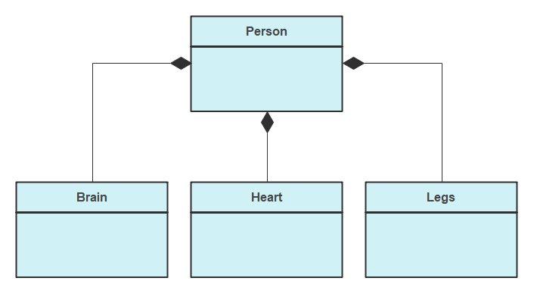
View Types
Composition Diagram

Slide 17
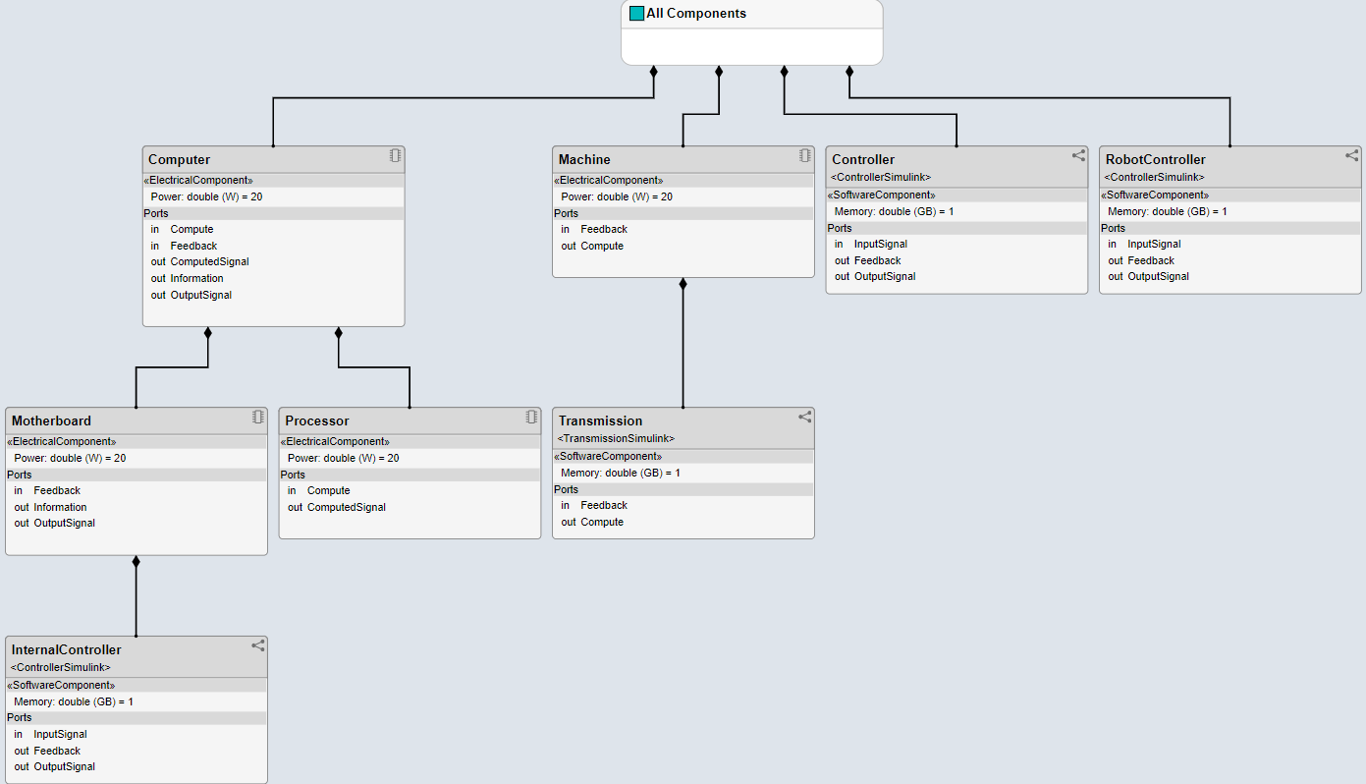
View Types
Composition Diagram (in System Composer)

Slide 18
View Types
Composition Diagram: Composition vs. Aggregation
Car
Car
Engine
Passengers
Composition: every car has an engine
Aggregation: cars may have passengers, they come and go

Slide 19
View Types
Composition Diagram: Composition vs. Aggregation
Car
Car
Aggregation: delete the car and the passenger can travel somewhere else
Engine
Composition: delete the car and the engine is useless

Slide 20

View Types
Use-case Diagram
Transfer money
<<include>>
client
Check status
Withdraw money
Bank officer
ATM

Slide 21
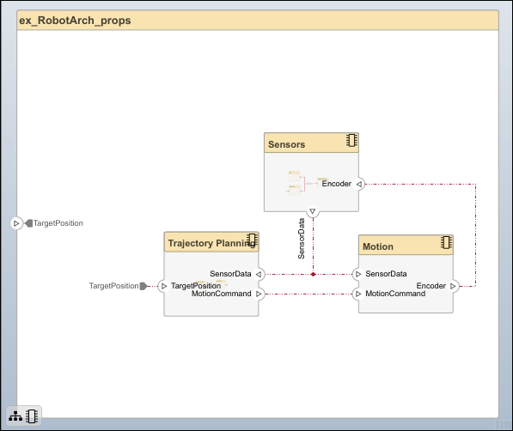
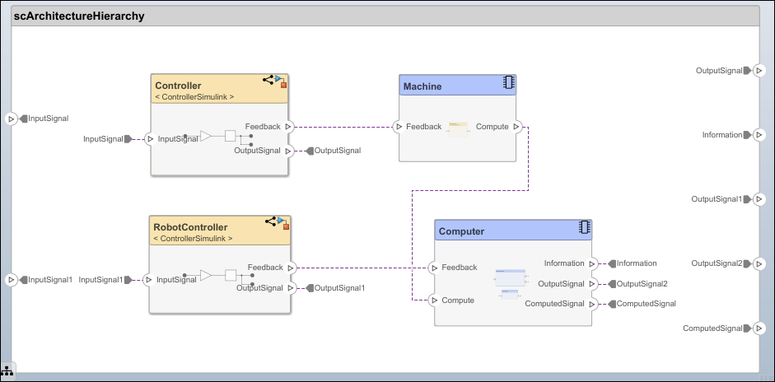
View Types
Interfaces

Slide 22
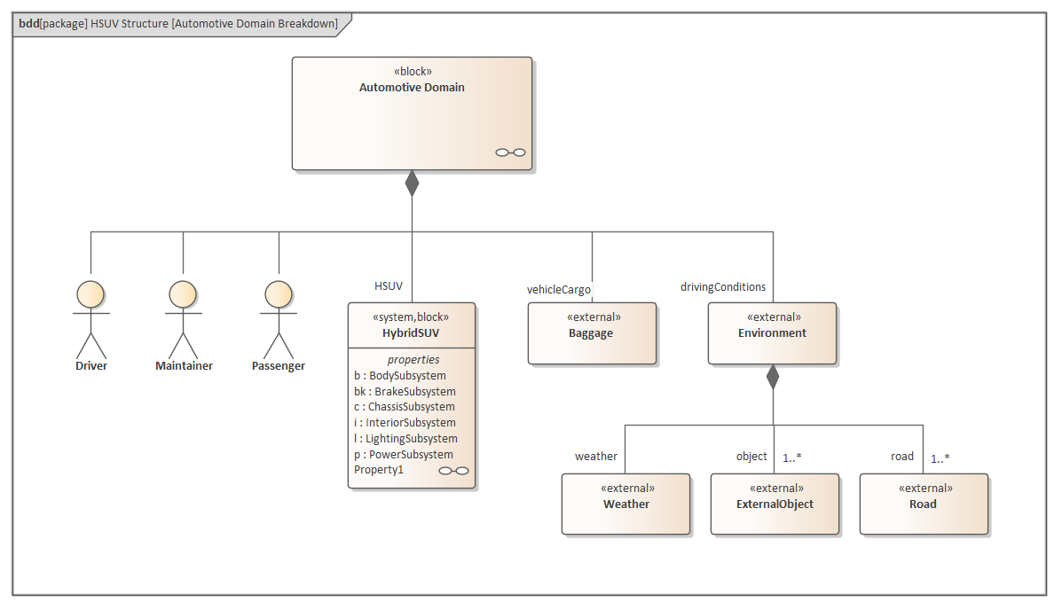
View Types : Standard modelling languages
Architecture modelling can be performed following different languages.
SysML is a general-purpose graphical modelling language for specifying, analyzing, designing, and verifying complex systems.
https://sparxsystems.com/enterprise_architect_user_guide/14.0/model_domains/sysml.html

Slide 23
References
3

Slide 24
References
System Architecture. Strategy and Product Development for Complex Systems E. Crawley, B.Cameron, D. Selva (2016)
Systems Architecting. A Business Perspective Gerrit Muller (2012)
The secret of APOLO. Systems Management in American and European Space Programs Stephen B. Johnshon (2002)
Architecting Software Intensive Systems. A Practitioner’s Guide Anthony J. Lattanze (2009)

Slide 25
Eskerrik asko
Muchas gracias
Thank you
Paul Aretxederreta
paretxederreta@cafpower.com
www.linkedin.com/in/paul-aretxederreta
Parque Tecnológico de San Sebastián
Paseo Mikeletegi, 58 - 2º
20009 San Sebastián • Spain
www.cafpower.com

